Slide 1
Girls into Coding activity 3 images

Slide 2
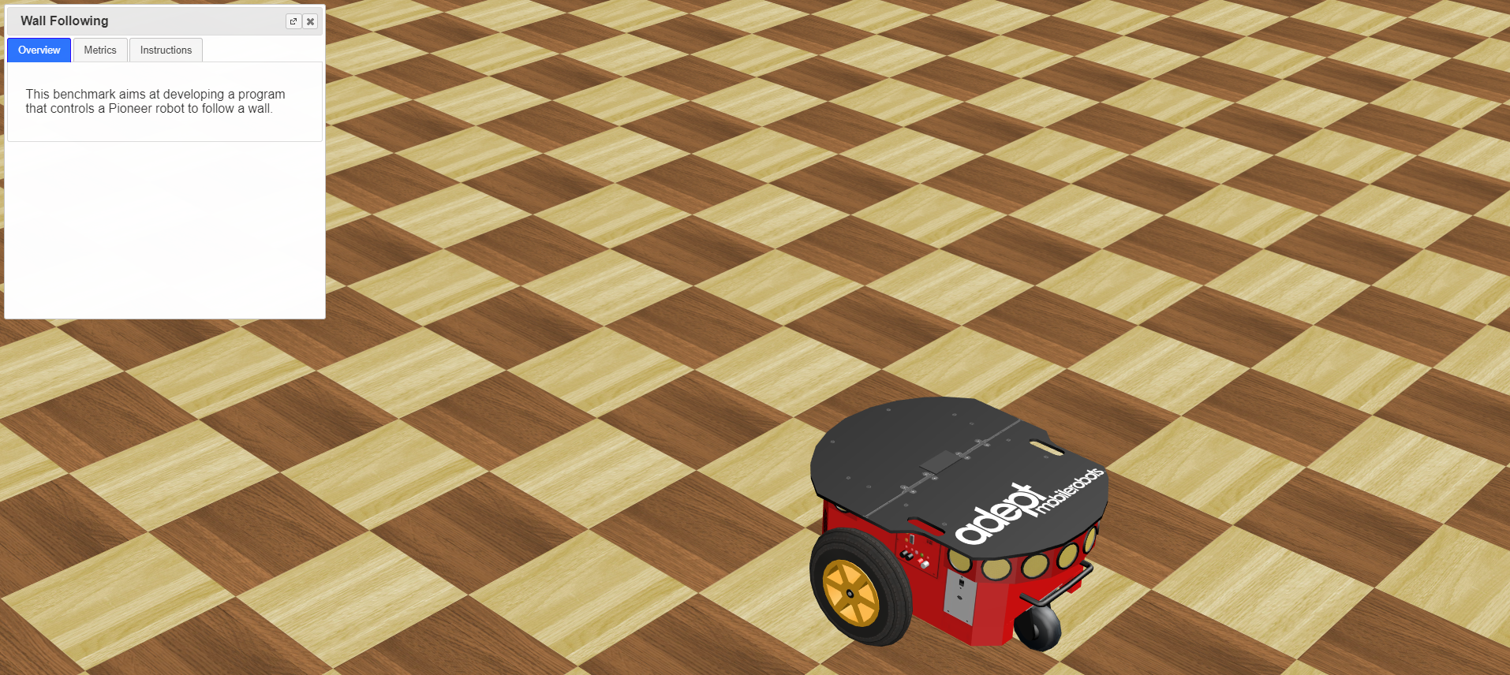
Image 1
We can close these instructions for the moment, we won’t use them yet for this activity! We will take a look at them later on ☺!
This is our robot ! ☺
These yellow spots are the robot’s ultrasonic distance sensors!!

Slide 3
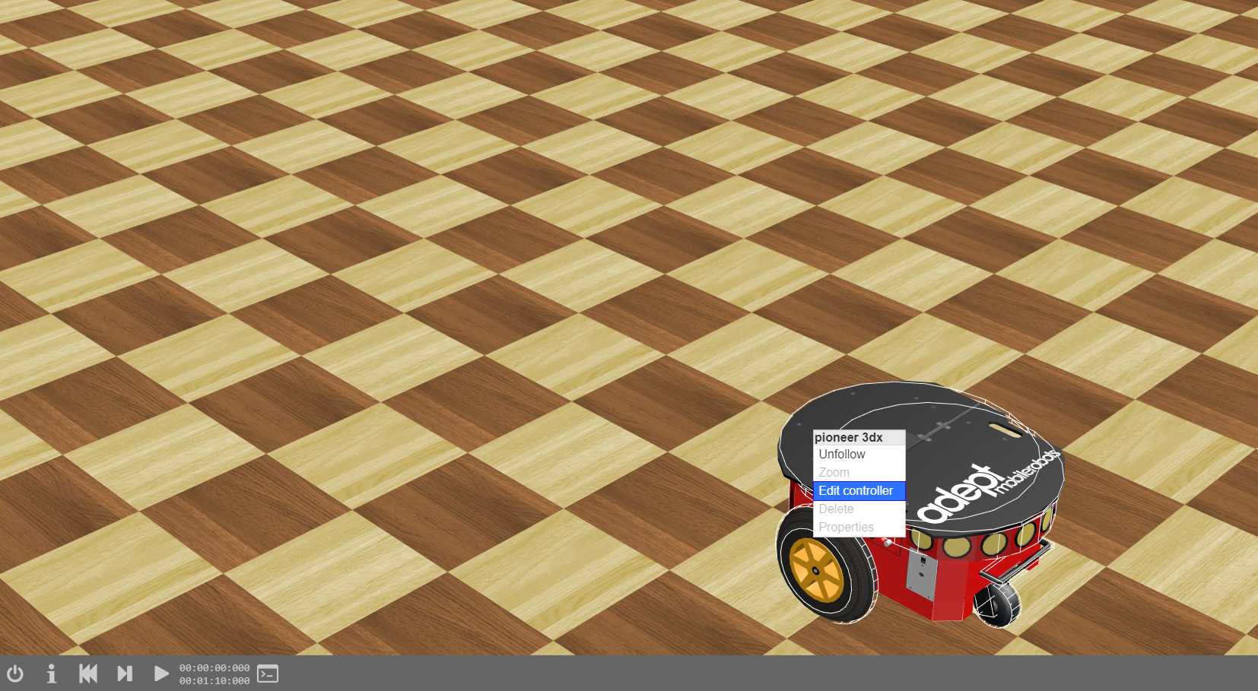
Image 2
[1] Right click on the robot
[2] Click: Edit controller

Slide 4
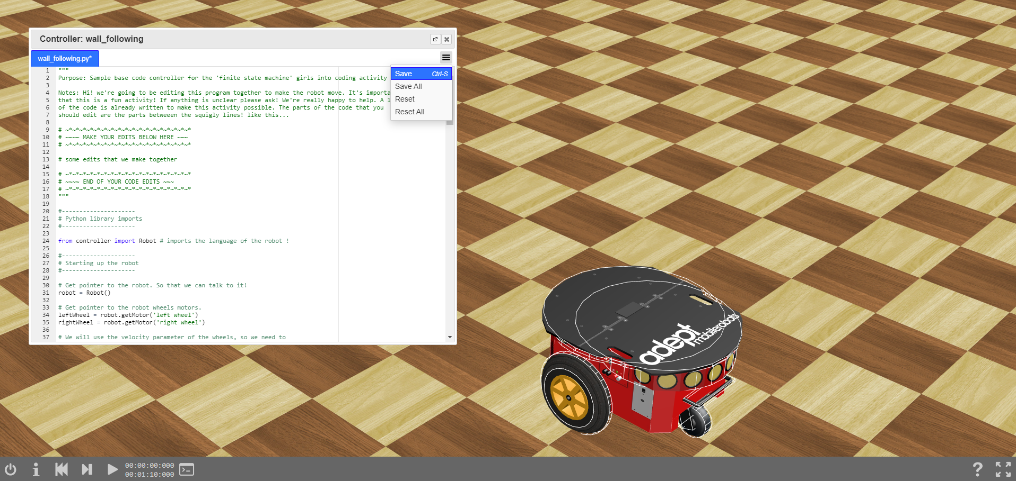
Image 3
[1] We should end up with the new code pasted in the controller window
[2] Click the menu icon, then -> Save
[3] Reset simulation
[4] Start simulation

Slide 5
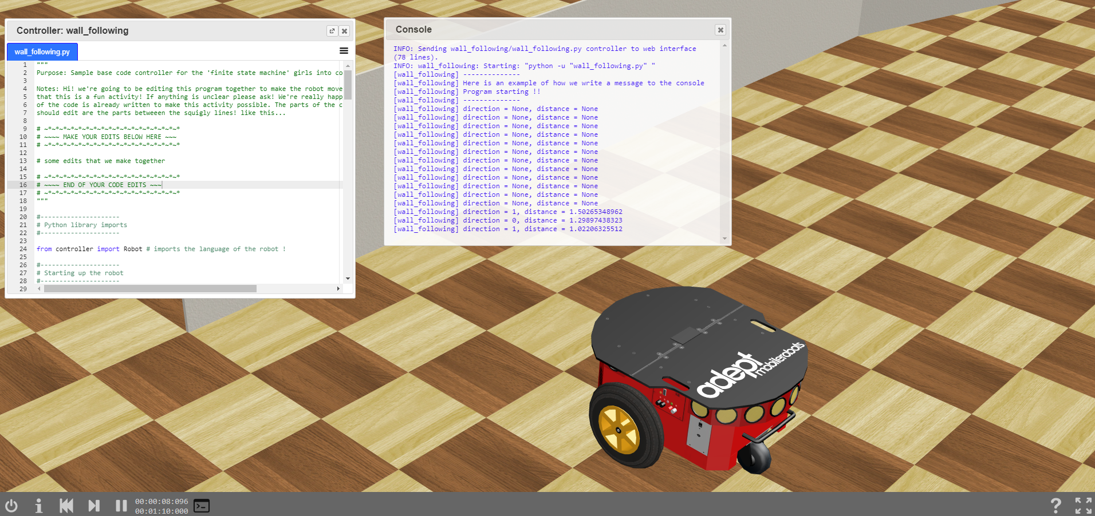
Image 5
[2] We should see this window pop up! We can see our messages from the robot here
[5] Have a look at how the messages change as the robot approaches the wall!
[3] Reset the simulation
[4] Start the simulation
[1] Click console

